Slide 1

Introduction to Cost Accounting
Lecture #1

Slide 2
Learning Outcomes
Comprehend the need and purpose of cost accounting and its related concepts.
Appraise the differences between cost accounting & management accounting.

Slide 3
What Yes Bank is actually doing?
Cost Accounting
Adopting the formal system
Cost Ascertainment
This system determines & controls the cost of its products and services
Calculation of actual costs incurred
Cost control
Identifying and reducing business expenses to increase profits

Slide 4
How multiplexes are following the principles of cost accounting?
Principles
Control & reduce cost
Fix the selling prices
Budgeting
Setting performance standards
Cost determination

Slide 5
Poll – I
Multiplexes operating in India must ensure that in future coming years, the operating cost must not rise beyond a certain point.
Which of the following ‘futuristic approach’ of cost accounting such multiplexes must use to keep its cost in check?
It must set budgets and determine the future outflow of expenses in advance.
It must provide the current cinema services at the low cost.
It must go out business during pandemic times and make a suitable comeback after the pandemic is over.
All of the above
Notes:
a

Slide 6
Poll – II
On the basis of the news discussion, analyze which of the following ‘cost objective’ will be achieved by ICICI bank?
The bank can fix the higher selling price of granting loans and earn more profits.
The bank can cut its significant costs related to granting of loans to farmers.
The bank can help the farmers to improve the crop quality of crops grown by them.
The bank can provide more travel benefit plans to its employees at low cost.
Notes:
B

Slide 7
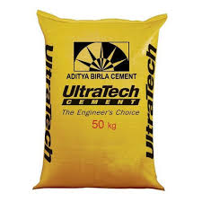
UltraTech Cements – Analyzing the Total Cost of making 1 cement bag (40 Kgs.)
Following is the break – down the total cost = Rs. 300 (in Rs.) of manufacturing one bag of cement (40 Kgs) approximately.
Raw Material Cost = 75
Labor Cost = 100
Total Cost = 300
Fuel & Power Cost = 125

Slide 8
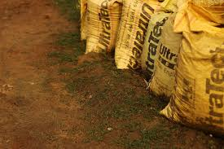
‘COSTING’ of 1 cement bag (40 Kgs.) of ‘UltraTech’
Technique of ‘Ascertaining costs’.
Finding out the breakup of the total cost from the recorded data
Classifying the recorded costs and summarizing at each element.

Slide 9
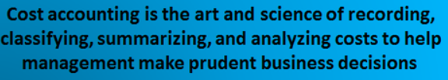
So what is cost accounting?????

Slide 10
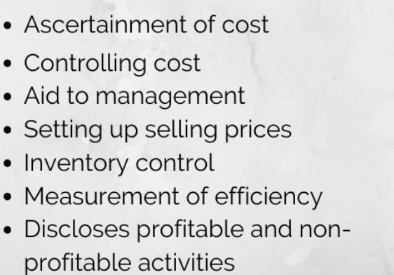
Functions of Cost Accounting

Slide 11

Case Analysis Application of cost accounting principles at Britannia
Cost reduction
Through use of efficient supply chain
Setting Standards
Managers held accountable for poor performance of ‘unit’ under their control
Budgeting
Planning in advance the total cost to be incurred for each food product
Eliminating wastages

Slide 12
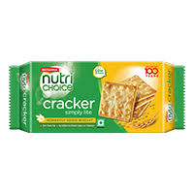
Poll – III
The total cost to manufacture each biscuit packet of 50 grams is Rs. 10.
The break down of this total cost is (raw material cost Rs. 4, labor cost Rs. 3 and other cost Rs. 3).
Which concept is applied in this case of Britannia?
Cost control
Cost cutting
Costing
Budgeting

Slide 13
Basis of difference | Management Accounting | Cost Accounting
Objective | To give useful details to management for decision-making. | To ascertain, reduce and control costs.
Types of Transactions | It deals both with financial and non-financial transactions. | It deals only with financial transactions.
Basis | This type of accounting purely deals with future transactions. | This type of accounting deals both with present and future transactions.
Scope | Management accounting has a wider scope as it covers the regions of financial accounts, cost accounts, and tax accounts. | Cost accounting has a confined scope as it covers matters only related to control of cost.
Utility | Management accounting helps just for the needs of intramural management. | This accounting helps for the needs of both external and internal parties.

